Slide 1

Clinical Definitions and CodelistGenerator
Epidemiology Track Day 2
T, 17th June 13.30-16.30h

Slide 2
https://github.com/oxford-pharmacoepi/RWE_summer_school_2024

Slide 3
Schedule
13.30 – 13.45 Phenotyping process reminder
13.45 – 14.00 Clinical description with Dynamed Demo
14.00 – 14.40 Breakout session: Clinical descriptions
14.40 – 15.00 Clinical descriptions and flavours chosen presented
15.00 – 15.15 Coffee Break
15.15 – 15.30 Code list Generation and Athena Demo
15.30 – 15.45 Breakout session: Turning CD into keywords and Code list Generation
15.45 - 16.00 Group presentation of findings
16.00 – 16.15 Breakout session: Code list Generation (II) and flavour review
16.15 – 16.30 Group discussion

Slide 4


Phenotyping reminder

Slide 5
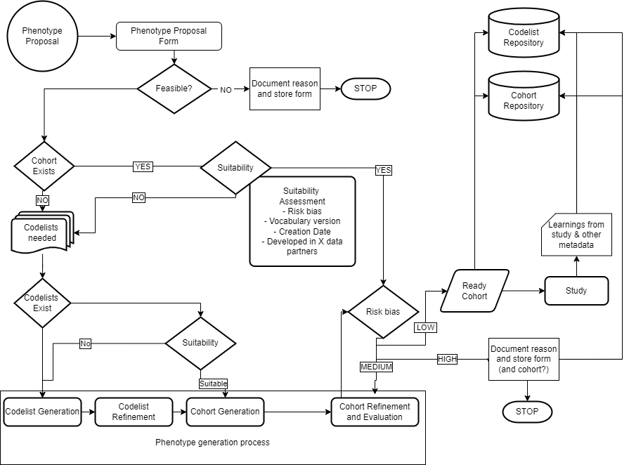
1. PROPOSAL
2. COHORT EXISTS?
Risk of
misclassification
3. CODELIST GENERATION
4. COHORT GENERATION

Slide 6


Slide 7
What is "phenotyping" in the context of electronic health records?
The process of collecting genetic data from patients
The method of identifying and classifying individuals based on observable traits or conditions
The statistical analysis of treatment outcomes
The procedure of assigning patients to different treatment arms in a study

Slide 8
1. Proposal
Phenotype proposal form
– Who asks? What is it for?
Evaluate:
- Feasibility – If non-feasible – STOP + reason
- Different than study feasibility (but related)
- Need for clinical description
- If yes, clinical description form

Slide 9
Clinical Description
Overview
Presentation
Assessment
(Staging)
Management/RX
Prognosis
Disqualifiers
Strengtheners
Suggested Logic Description:
Proposed Flavours

Slide 10
Clinical Description with Dynamed
try to connect!
https://dpa-pde-oxford.shinyapps.io/OSS_Dynamed_shiny/
User: summerschool2024
Password: oxford

Slide 11
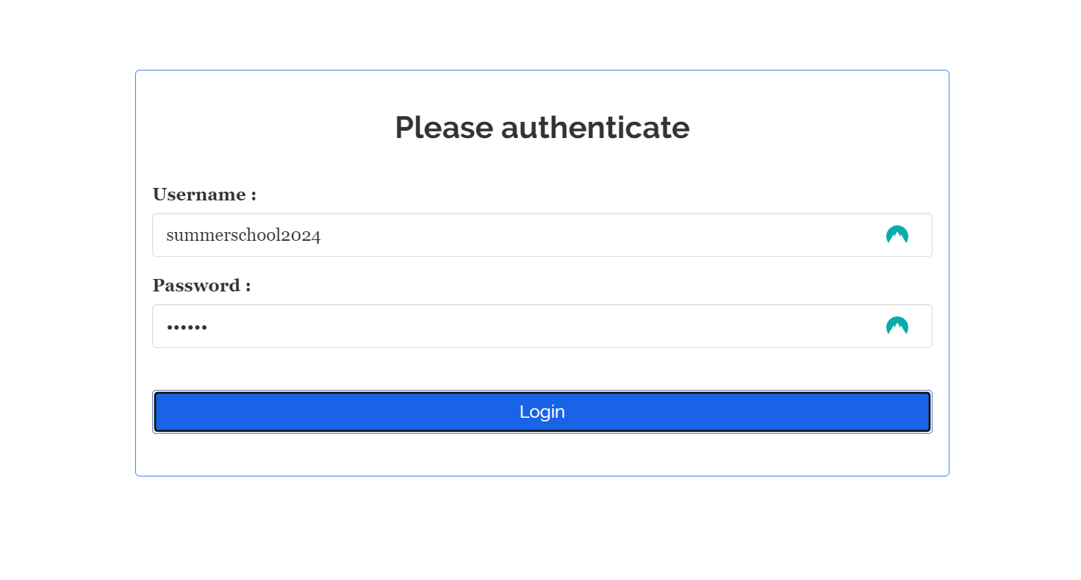
Clinical Description with Dynamed
1 – Log In

Slide 12
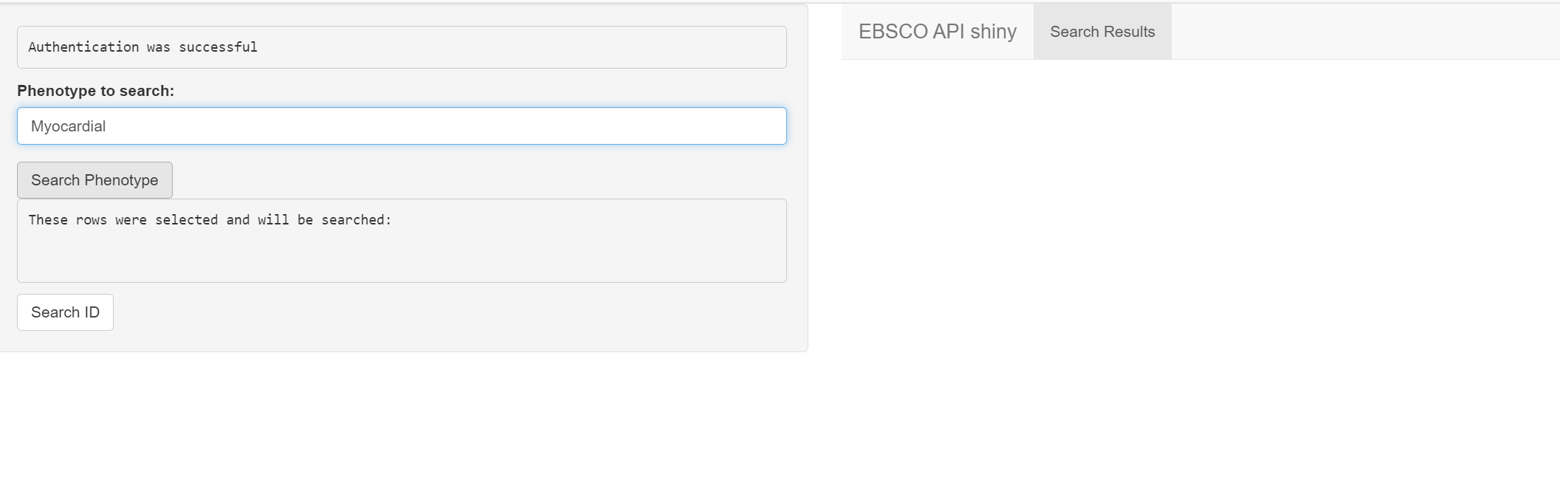
Clinical Description with Dynamed
2 – Search
1- Search word goes here
3- Results appear here
2- Click here

Slide 13
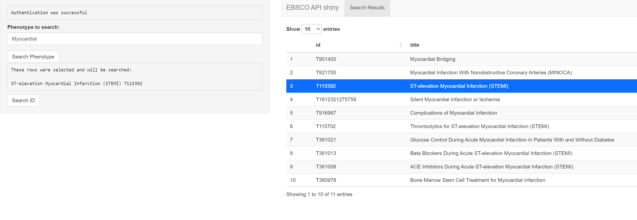
Clinical Description with Dynamed
2 – Search
3- New tabs will appear here
(Selected result gets
printed here too)
2- Click here
1 – Click on one of the results
(it gets highlighted)

Slide 14
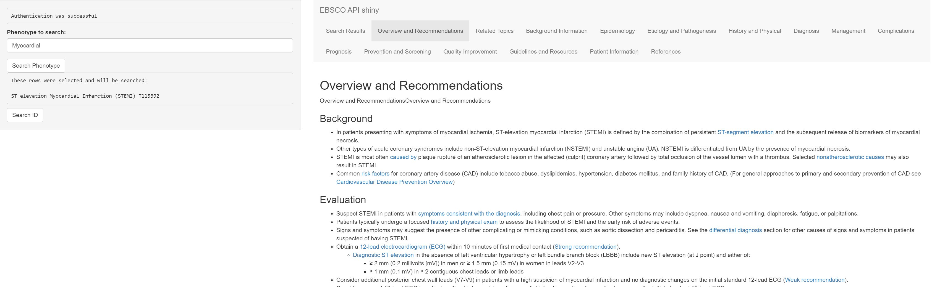
Clinical Description with Dynamed
Consult
1- Click the selected tab
Relevant information
to copy paste
appears here

Slide 15
Breakout Session
Complete a clinical description
of the selected phenotypes
for an incidence/prevalence study
Most Important:
Think about flavours,
possible logics,
What code lists/concept sets would you need?

Slide 16
Breakout Session
14.00 – 14.40 Breakout session: Clinical descriptions
14.40 – 15.00 Clinical descriptions and flavours chosen presented
https://dpa-pde-oxford.shinyapps.io/OSS_Dynamed_shiny/
User: summerschool2024
Password: oxford

Slide 18
Why are clinical descriptions useful in the process of phenotyping?
To clearly define the condition we want to identify
To have an up-to-date summary of the expected incidence and prevalence
To define the different flavours or variants we may want
All the previous answers are true

Slide 19
Why are clinical descriptions useful in the process of phenotyping?
To clearly define the condition we want to identify
To have an up-to-date summary of the expected incidence and prevalence
To define the different flavours or variants we may want
All the previous answers are true

Slide 20
3. New phenotype generation
3.1 – Codelist generation
3.2 – Codelist refinement
3.3 – Cohorts generation

Slide 21
Phenotyping reminder

Slide 22
1. PROPOSAL
2. COHORT EXISTS?
Risk of
misclassification
3. CODELIST GENERATION
4. COHORT GENERATION

Slide 23

3.1 Codelist generation
Generate a first codelist (systematic way if possible)
That works with all the vocabularies potentially involved
Tools:
Codelist generator

Slide 24
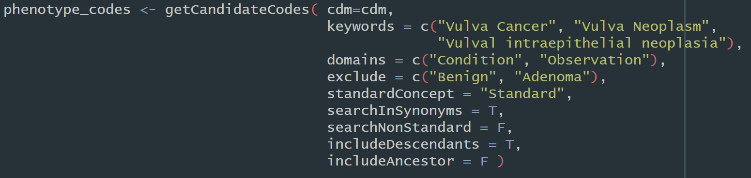
Codelist generator

Slide 25
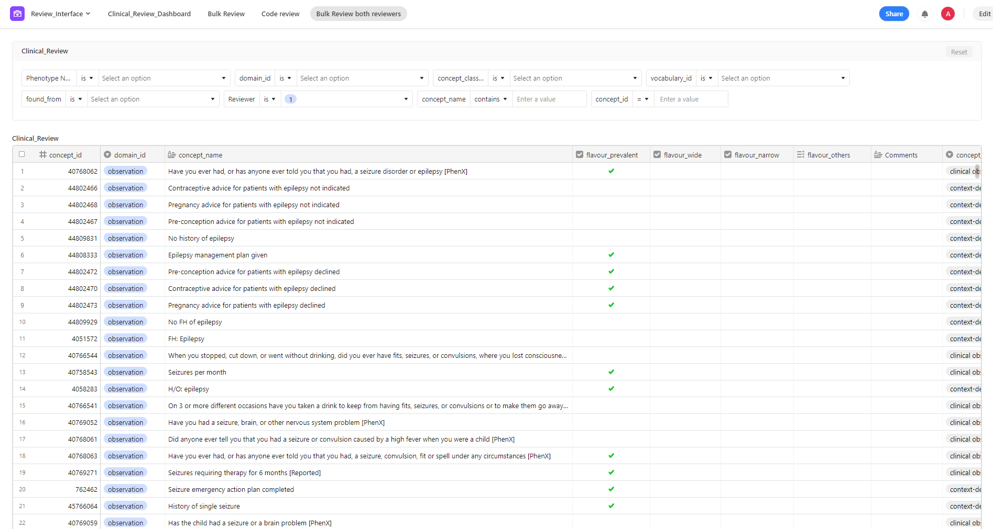

Slide 26
3.2 Codelist refinement
Clinical review
- Two independent reviewers
- Third ‘referee’
Potentially code recommender tools
Delimitate cohort flavours
- Narrow vs Broad
- Incident vs Prevalent
- Secondary vs Primary vs All
- …

Slide 27
Breakout Session
Try codelist generator
Use codelist generator and Athena
https://dpa-pde-oxford.shinyapps.io/CodeListGenerator_shiny_SS24_2/
https://dpa-pde-oxford.shinyapps.io/CodeListGenerator_shiny_SS24/
https://athena.ohdsi.org/

Slide 28
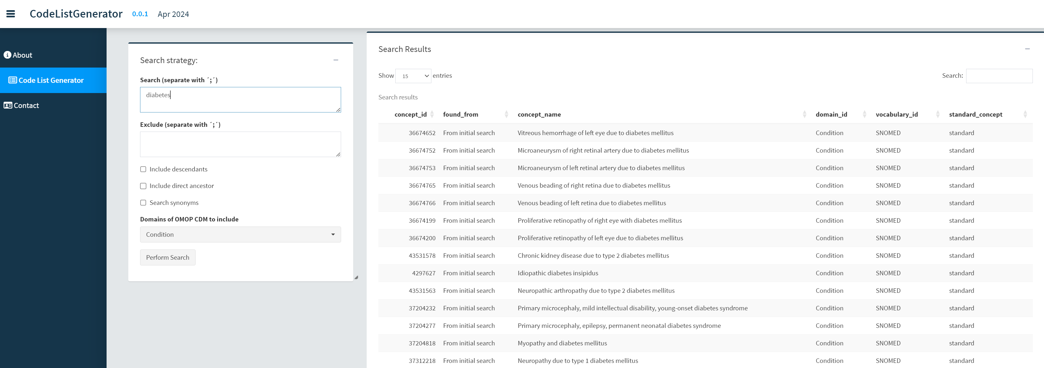
Codelist Generator
1. Keywords to search
and options here
Results will appear here
2- Click here

Slide 29
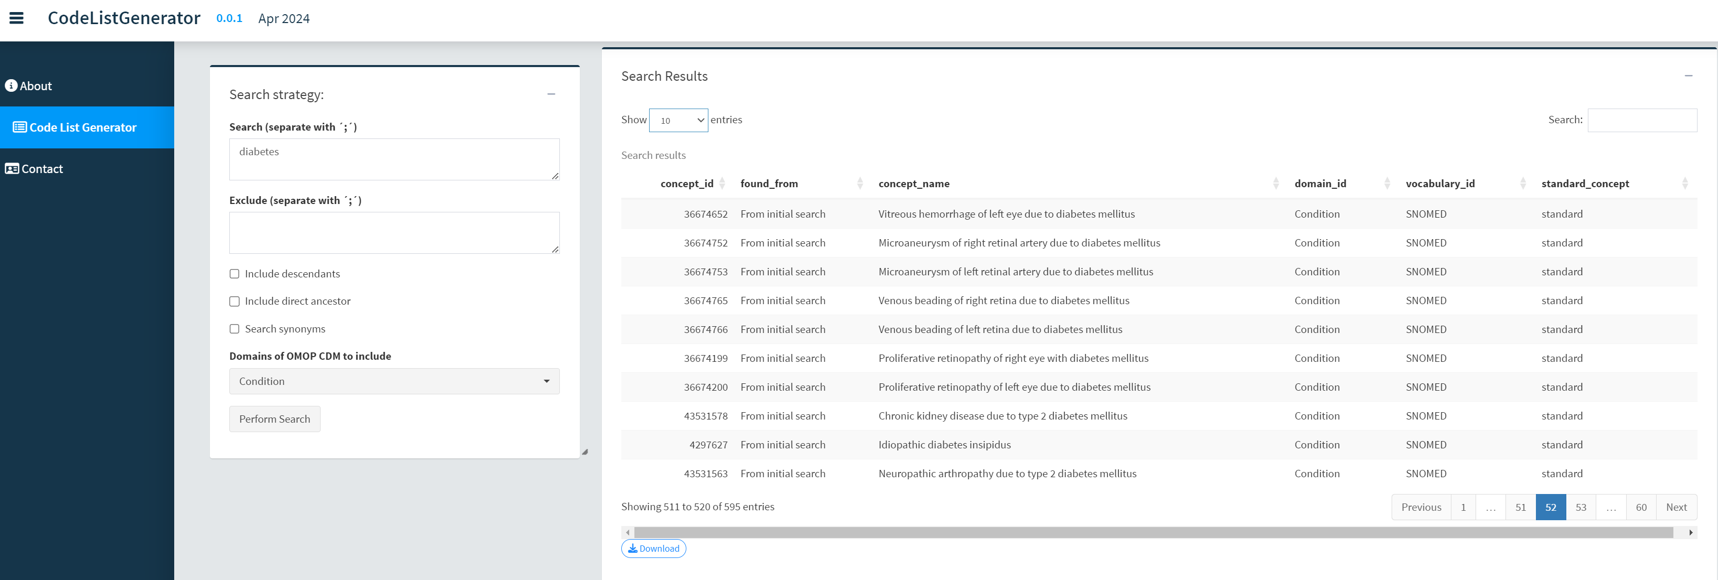
Codelist Generator
3- Download excel file here

Slide 30
Breakout Session
Try codelist generator
Use codelist generator and Athena
https://dpa-pde-oxford.shinyapps.io/CodeListGenerator_shiny_SS24_2/
https://dpa-pde-oxford.shinyapps.io/CodeListGenerator_shiny_SS24/
https://athena.ohdsi.org/

Slide 31
Breakout Session
Try codelist generator
Use codelist generator and Athena
Outputs:
Keywords
Any exclusions?
Options: descendants/ancestors/synonyms
Domains
N of codes
https://dpa-pde-oxford.shinyapps.io/CodeListGenerator_shiny_SS24/
https://dpa-pde-oxford.shinyapps.io/CodeListGenerator_shiny_SS24_2/
https://athena.ohdsi.org/search-terms/start

Slide 32
Final Thoughts
Cohort creation

Slide 33
3.3 Cohort definition
Cohort for each flavour:
Determine start of follow up criteria:
Index event/s
Inclusion/exclusion criteria
Time in observation
Determine end of follow up:
Duration disease/drug use
Death
End of observation
Censor at certain events
Tools:
- capR
- ATLAS
- CohortConstructor

Slide 35


Slide 36
When constructing a codelist/concept set for a phenotype, which of the following practices helps ensure its comprehensiveness and accuracy?
Using only a single code for each disease
Relying solely on automated code generation tools
Run diagnostics and review orphan codes
Avoiding peer review to expedite the process

Slide 37
When constructing a codelist/concept set for a phenotype, which of the following practices helps ensure its comprehensiveness and accuracy?
Using only a single code for each disease
Relying solely on automated code generation tools
Run diagnostics and review orphan codes
Avoiding peer review to expedite the process

Slide 38
Which of the following best describes a cohort study?
study that selects individuals with a disease and compares them to individuals without the disease.
A study that follows a group of people over time to assess how certain exposures affect outcomes.
A study that uses each participant as their own control to assess the effect of an exposure.
A study that assigns participants randomly to different treatment groups.

Slide 39
Which of the following best describes a cohort study?
study that selects individuals with a disease and compares them to individuals without the disease.
A study that follows a group of people over time to assess how certain exposures affect outcomes.
A study that uses each participant as their own control to assess the effect of an exposure.
A study that assigns participants randomly to different treatment groups.

Slide 40
In a self-controlled case series (SCCS) design, what is an advantage?
It requires a large sample size.
It reduces confounding by using within-subject comparisons.
It guarantees an endless supply of self-reflection and existential dread.
It always provides higher external validity compared to other study designs.

Slide 41
In a self-controlled case series (SCCS) design, what is an advantage?
It requires a large sample size.
It reduces confounding by using within-subject comparisons.
It guarantees an endless supply of self-reflection and existential dread.
It always provides higher external validity compared to other study designs.

Slide 42
What is a strengthener in the context of a Clinical Definition?
It's the medical term for a double shot of espresso.
A strengthener is actually just chicken soup, according to your grandma’s clinical definition.
A characteristic (drug, condition, test, measurement) that when seen happening in our cohort increases our trust on the phenotype
It’s the Incidence and Prevalence of the disease in the world

Slide 43
What is a strengthener in the context of a Clinical Definition?
It's the medical term for a double shot of espresso.
A strengthener is actually just chicken soup, according to your grandma’s clinical definition.
A characteristic (drug, condition, test, measurement) that when seen happening in our cohort increases our trust on the phenotype
It’s the Incidence and Prevalence of the disease in the world

Slide 44
What does the “Include ancestor” option do in CodelistGenerator?
Sends the codelist to your family for review
Includes the codes directly above in the tree of included terms in the results
Includes the codes directly below in the tree of included terms in the results
It makes your codelist feel nostalgic by including all its elders.

Slide 45
What does the “Include ancestor” option do in CodelistGenerator?
Sends the codelist to your family for review
Includes the codes directly above in the tree of included terms in the results
Includes the codes directly below in the tree of included terms in the results
It makes your codelist feel nostalgic by including all its elders.

Slide 46

And the epi star award goes to…

